Slide 1
Arrhythmia definitions

Slide 2
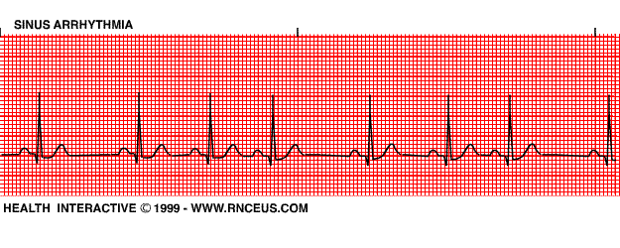
Arrhythmia definitions
Sinus Arrhythmia
Phasic variation in the heart rate (sinus arrhythmia) is normal. Typically, the sinus rate varies with the respiratory cycle, whereas P-QRS-T intervals remain stable.

Slide 3
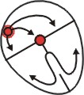
Arrhythmia definitions
Sinus tachycardia
Rapid heart rate for age.
P waves normal morphology and axis.
Narrow (< 80 ms) complex tachycardia.
Frequent oscillations in heart rate with gradual acceleration and gradual slowing.
Sinus tachycardia in a 2 years old toddler

Slide 4
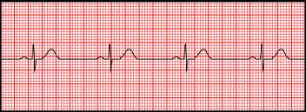
Arrhythmia definitions
Sinus bradycardia
Slow heart rate for age.
P waves normal morphology and axis.
Narrow QRS complex.

Slide 5
causes
Sinus node disease
Hypothyroidism
Hypothermia
Electrolyte abnormalities – hyperkalaemia, hypermagnesaemia
Brainstem herniation (the Cushing reflex)

Slide 6
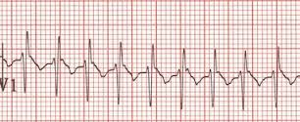
Arrhythmia definitions
SVT
rate of 220-230/min
Regular narrow (< 80 ms) complex tachycardia.
Uniform and of sudden onset and offset.

Slide 7
Site of Origination | Automatic Mechanisms | Re-entrant Mechanisms
Sinus node | Sinus tachycardia | Sinoatrial node reentry
Atrium | Ectopic atrial tachycardia Multifocal atrial tachycardia | Atrial flutter Intra-atrial reentrant tachycardia Atrial fibrillation
Atrioventricular node | Junctional ectopic tachycardia | Atrioventricular nodal reentrant tachycardia (AVNRT)
Accessory pathways |  | Concealed accessory pathways Wolff-Parkinson-White (WPW) syndrome Permanent form of junctional reciprocating tachycardia (PJRT) Mahaim fiber tachycardia

Slide 8
atrial flutter
Atrial flutter is a type of supraventricular tachycardia caused by a re-entry circuit within the right atrium.

Slide 9
Arrhythmia definitions
Atrial premature beats
Premature P-wave with abnormal morphology.
may be conducted or nonconducted.
The pause after a PAC is usually incomplete - i.e. the PAC usually enters the sinus node and resets its timing, causing the next sinus P to appear earlier than expected (premature ventricular complexes, by contrast, are usually followed by a complete pause because they do not usually disturb the sinus node).

Slide 10
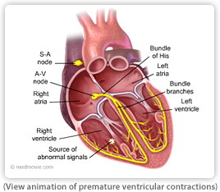
Arrhythmia definitions
Ventricular premature beats(PVCs)
premature, widened, bizarre QRS
followed by a full compensatory pause

Slide 11
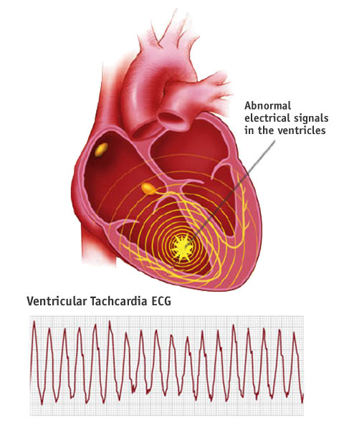
Arrhythmia definitions
VT
at least three PVCs at >120 beats/min

Slide 12
Arrhythmia definitions
First-degree heart block
Prolongation of the PR interval.

Slide 13
Arrhythmia definitions
Second degree heart block : Mobitz type I progressive prolongation of the PR interval until there is no QRS following a P wave

Slide 14
Arrhythmia definitions
Second degree heart block :Mobitz type II
There is no progressive lengthening of the PR interval before the dropped beat.

Slide 15
Arrhythmia definitions
Complete heart block
AV dissociation.
Atrial rate > ventricular rate

Slide 16
Sinus Node Dysfunction (Sick Sinus Syndrome)
A disease characterised by abnormal sinus node functioning with resultant bradycardia and cardiac insufficiency.
Drugs e.g. digoxin, beta-blockers, calcium channel blockers.
Autonomic dysfunction.
Hypothyroidism.
Electrolyte abnormalitites — e.g. hyperkalaemia

Slide 17
ECG in Sinus Node Dysfunction
Sinus Bradycardia
Sinus Arrest — pause > 3 seconds.
Bradycardia – tachycardia syndrome.
Wide range of clinical symptoms including syncope, near-syncope, dizziness, fatigue and palpitations.

Slide 18
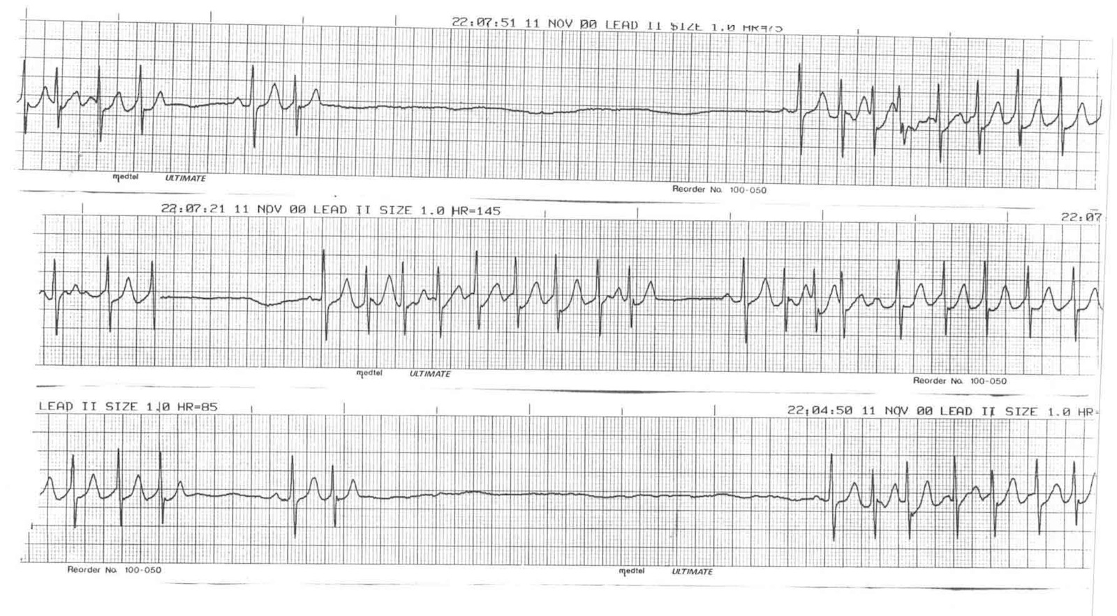

Slide 19
Definition of ECG variables
Wolf Parkinson White Syndrome (WPWS):
pre-excitation syndrome characterized by the occurrence of SVT plus specific ECG findings in sinus rhythm.

Slide 20
Definition of ECG variables
Wolf Parkinson White Syndrome
The characteristic pre-excitation is evidenced by a short PR interval and widened QRS with a slurred upstroke or delta wave.

Slide 21
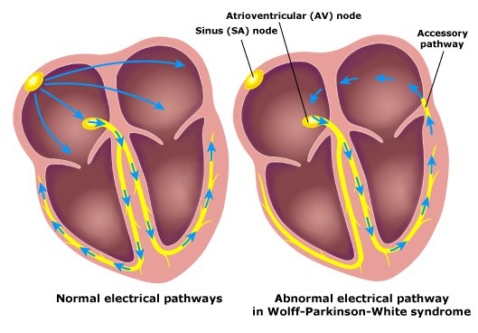
Definition of ECG variables
Wolf Parkinson White Syndrome is caused by earlier ventricular excitation occurring via the accessory pathway than have occurred via the normal AV node alone (Harahsheh et al, 2008).

Slide 22
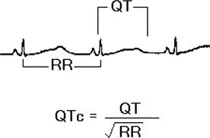
Definition of ECG variables
Long QT Syndrome:
Long QT syndrome is a malignant disorder of cardiac conduction where cardiac repolarization is prolonged (QTc measurement on ECG) .

Slide 23
Definition of ECG variables
Long QT Syndrome:
This syndrome predisposes the patient to sudden episodes of syncope, seizures, or sudden death (5% per year if untreated). The mechanism is a pause-dependent initiation of torsades de pointes, a multifocal ventricular tachycardia.
Polymorphic VT / Torsades de Pointes: occurs in long QT syndrome and with some drugs. Causes syncope if self-terminating or cardiac arrest if prolonged (i.e. degenerates to VF) (Edward, 2012).

Slide 24
Definition of ECG variables
Long QT Syndrome:
It can be congenital or acquired.
Congenital long QT syndrome is inherited in an autosomal dominant (more common) or recessive pattern or it may occur spontaneously (less likely).

Slide 25
Definition of ECG variables
Long QT Syndrome:
Long QT syndrome can also be acquired, resulting from altered ventricular repolarization secondary to myocardial toxins, ischemia, or inflammation. Numerous medications can also cause QT prolongation (Vetter et al, 2008).

Slide 26
Definition of ECG variables
Short QT syndrome
It can be congenital or acquired
Short QT syndrome (SQTS) is an inheritable primary electric disease of the heart characterized by abnormally short QT intervals on the ECG and an increased propensity to develop atrial and ventricular tachyarrhythmias.

Slide 27
Definition of ECG variables
Short QT syndrome
It is a relatively recent addition to the list of inherited channelopathies responsible for sudden cardiac death (SCD) in individuals with structurally normal hearts.

Slide 28
Definition of ECG variables
Short QT syndrome
Secondary Causes of SQT Interval
Hyperkalemia
Hypercalcemia
Hyperthermia
Acidosis
Effect of catecholamine
Effects of drugs such as digitalis
Chinmay ,2010

Slide 29
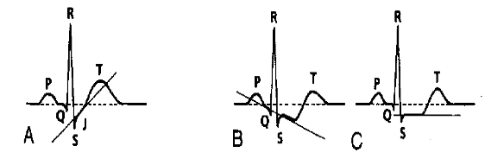
Definition of ECG variables
ST segment changes
The normal ST is isoelectric. Elevation or depression is judged in relation to the TP segment. A deviation by more than 2 squares in the pericordial leads is pathologic.
A = upsloping ST depression / J-point depression (normal variant)
B = downsloping ST depression (usually abnormal)
C = horizontal ST depression (usually abnormal)

Slide 30
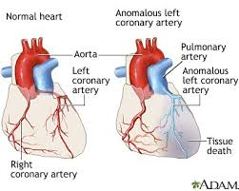
Definition of ECG variables
Pathological ST segment changes are commonly associated with T wave changes and occur in:
Pericarditis.
Myocardial ischaemia or infarction.
Severe ventricular hypertrophy
Digitalis effect.

